Slide 1


Advanced Computer Architecture Fall 2020
Hamed Farbeh
farbeh@aut.ac.ir
Department of Computer Engineering and Information Technology
Amirkabir University of Technology
Lecture 7

Slide 2
Copyright Notice
Lectures adopted from
Computer Architecture: A Quantitative Approach, 5th edition, John L. Hennessy,‎ David A. Patterson, MK pub., 2019
Advanced Computer Architecture-Fall 2020, AUT, Tehran, Iran

Slide 3
Computer Architecture
A Quantitative Approach, Sixth Edition
Chapter 5
Thread-Level Parallelism

Slide 4
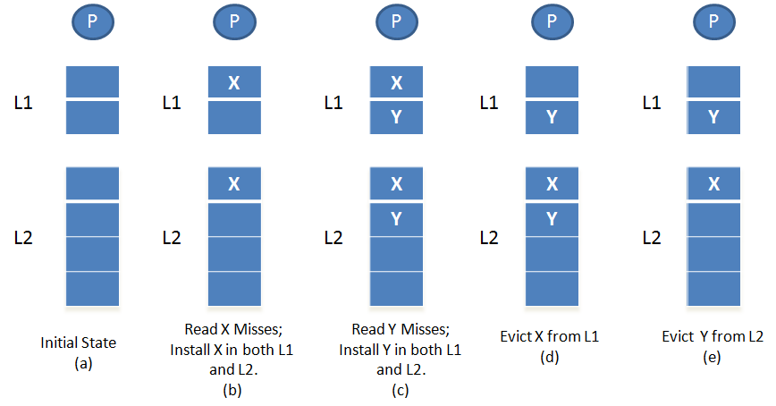
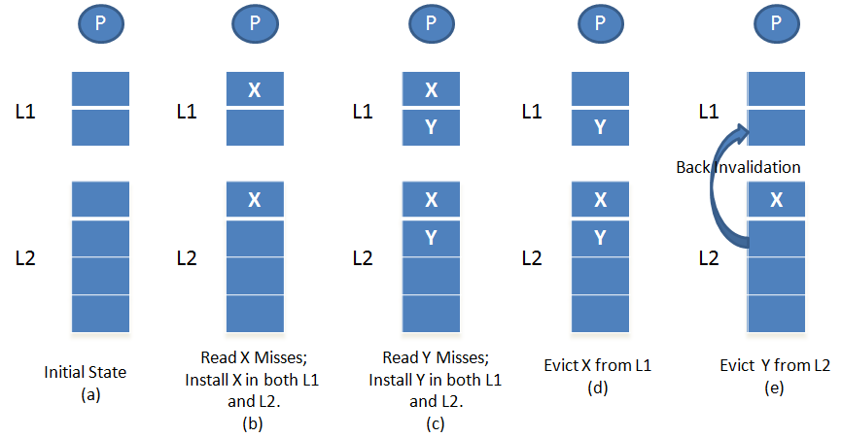
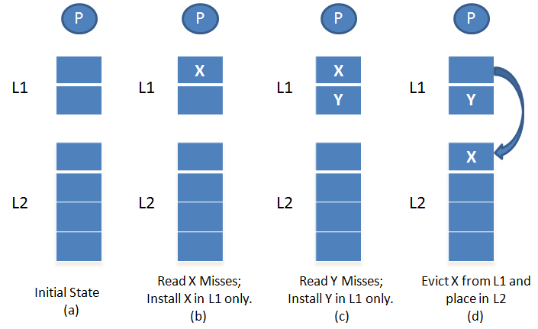
Cache inclusion policy
Inclusive Policy
Exclusive Policy
Non-inclusive non-exclusive (NINE)
Centralized Shared-Memory Architectures

Slide 5
Directory Protocols
Snooping schemes require communication among all caches on every cache miss
Limits scalability
Another approach: Use centralized directory to keep track of every block
Which caches have each block
Dirty status of each block
Implement in shared L3 cache
Keep bit vector of size = # cores for each block in L3
Distributed Shared Memory and Directory-Based Coherence

Slide 6
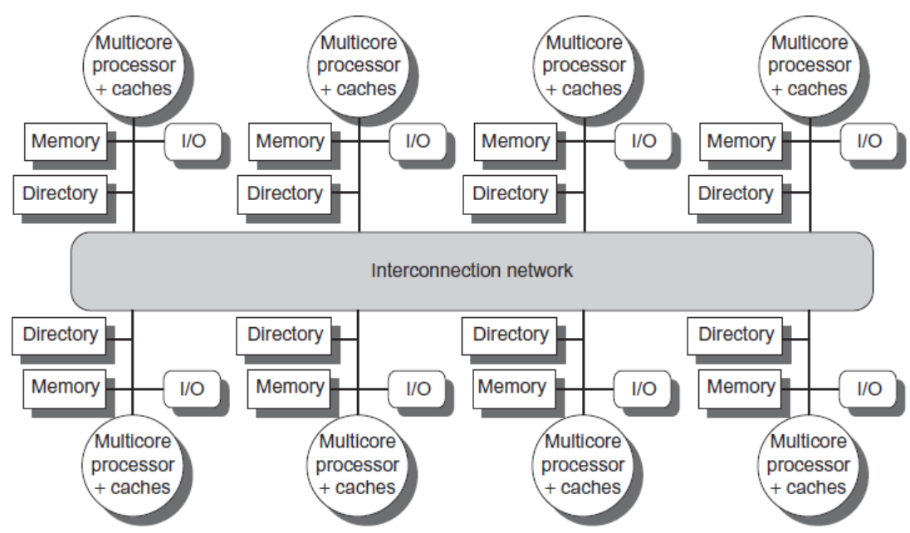
Directory Protocols
Alternative approach:
Distribute memory
Distributed Shared Memory and Directory-Based Coherence

Slide 7
Directory Protocols
For each block, maintain state:
Shared
One or more nodes have the block cached, value in memory is up-to-date
Set of node IDs
Uncached
Modified
Exactly one node has a copy of the cache block, value in memory is out-of-date
Owner node ID
Directory maintains block states and sends invalidation messages
Distributed Shared Memory and Directory-Based Coherence

Slide 8
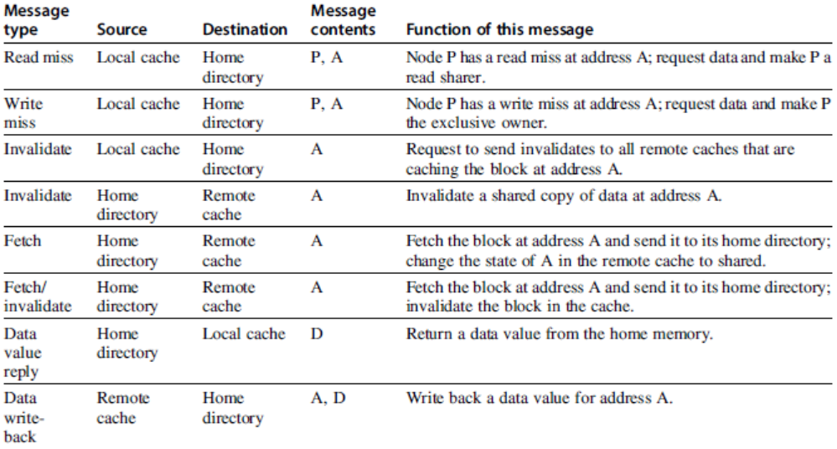
Messages
Distributed Shared Memory and Directory-Based Coherence

Slide 9
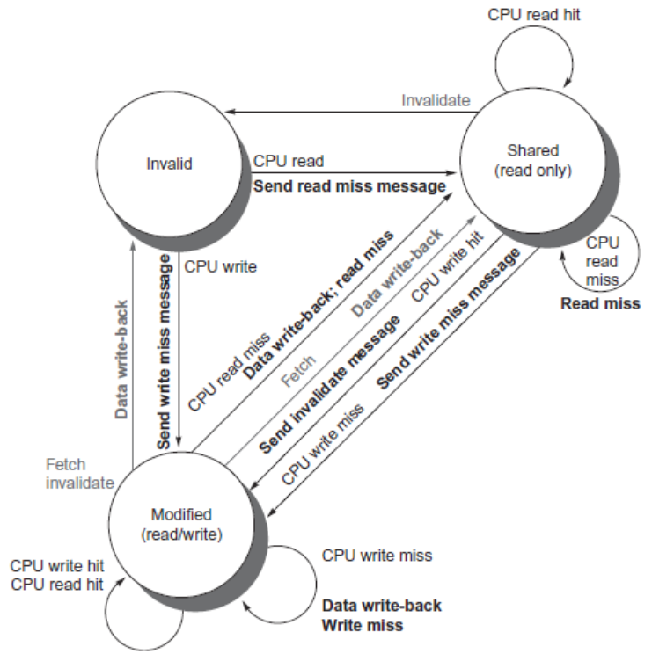
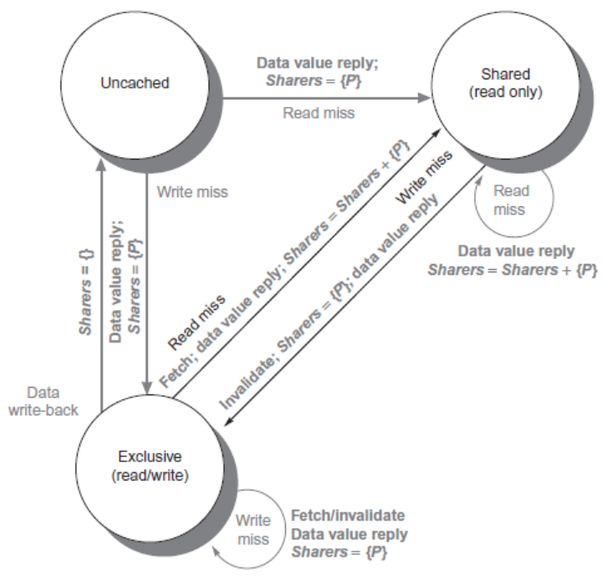
Directory Protocols
Distributed Shared Memory and Directory-Based Coherence

Slide 10
Directory Protocols
For uncached block:
Read miss
Requesting node is sent the requested data and is made the only sharing node, block is now shared
Write miss
The requesting node is sent the requested data and becomes the sharing node, block is now exclusive
For shared block:
Read miss
The requesting node is sent the requested data from memory, node is added to sharing set
Write miss
The requesting node is sent the value, all nodes in the sharing set are sent invalidate messages, sharing set only contains requesting node, block is now exclusive
Distributed Shared Memory and Directory-Based Coherence

Slide 11
Directory Protocols
For exclusive block:
Read miss
The owner is sent a data fetch message, block becomes shared, owner sends data to the directory, data written back to memory, sharers set contains old owner and requestor
Data write back
Block becomes uncached, sharer set is empty
Write miss
Message is sent to old owner to invalidate and send the value to the directory, requestor becomes new owner, block remains exclusive
Distributed Shared Memory and Directory-Based Coherence

